Slide 1
A Tour to Talend Open Studio and its usage
February 16, 2018
Presenter :

Slide 2
Introduction to Talend Open Studio

Slide 3
What is Talend Open Studio
Talend was founded in 2005 and is an open source software vendor providing
solutions for data integration, data quality, master data management, enterprise service bus, and business process management
Talend Open Studio for Data Integration is an open source graphical development environment for creating and deploying custom integrations between systems.
It comes with over 600 pre-built connectors that make it quick and easy to connect databases, transform files, load data, move, copy and rename files, and connect individual components in order to define complex integration processes.

Slide 4
Use Cases
ETL (Extract, Transform, and Load)
Data migration from one database to another
Regular file exchanges between systems:
Data synchronization
Data Cleanup
Data Scrapping

Slide 5
Pre-requisite for installing TOS
Hardware and software requirements:
To make the most out of the Talend products, please consider the following hardware and software requirements.
Memory usage - 3 GB minimum, 4 GB recommended
Disk usage - 3GB
Environment variable configuration: on Windows
Prior to installing your Talend solutions, you have to set the
JAVA_HOME Environment variable:
Define your JAVA_HOME environment variable so that it points to the JDK directory.

Slide 6
Working with TOS

Slide 7
Working with TOS
Starting the Talend Open Studio
Tour of the Talend Open Studio
o The Repository
o The design workspace
o The Palette
o Configuration tabs
o Outline and Code panels
Creating a new project
Creating an example job

Slide 8
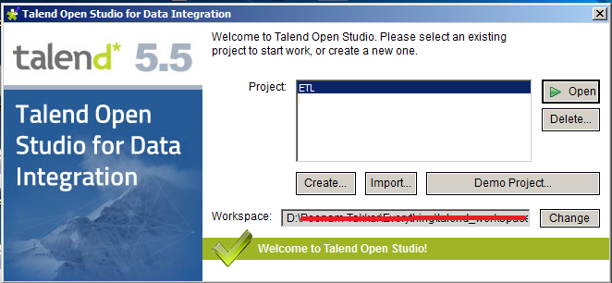
Starting the Talend Open Studio
Go to your installation directory and click on the exe as per your operating system. E.g. if you operating system is 64-bit, double-click on TOS_DI-win-x86_64.exe .

Slide 9
Starting the Talend Open Studio
In above window we can specify our workspace directory and select/create the project to work in.
Select project from the list provided and click on “Open” button.

Slide 10
Tour of the Talend Open Studio
The Repository
The design workspace
The Palette
Configuration tabs
Outline and Code panels

Slide 11
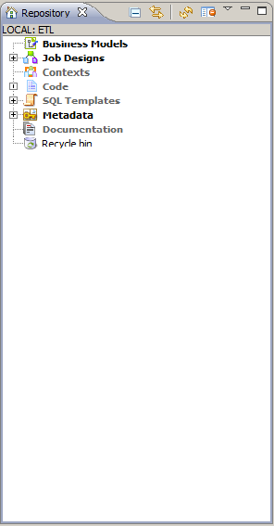
Repository
The Repository window, shown in the top-left of the Studio, contains all of the artefacts associated with a project. This will typically include:
• Job definitions
• Metadata items
• Reusable code snippets
• Business Models
• Contexts

Slide 12
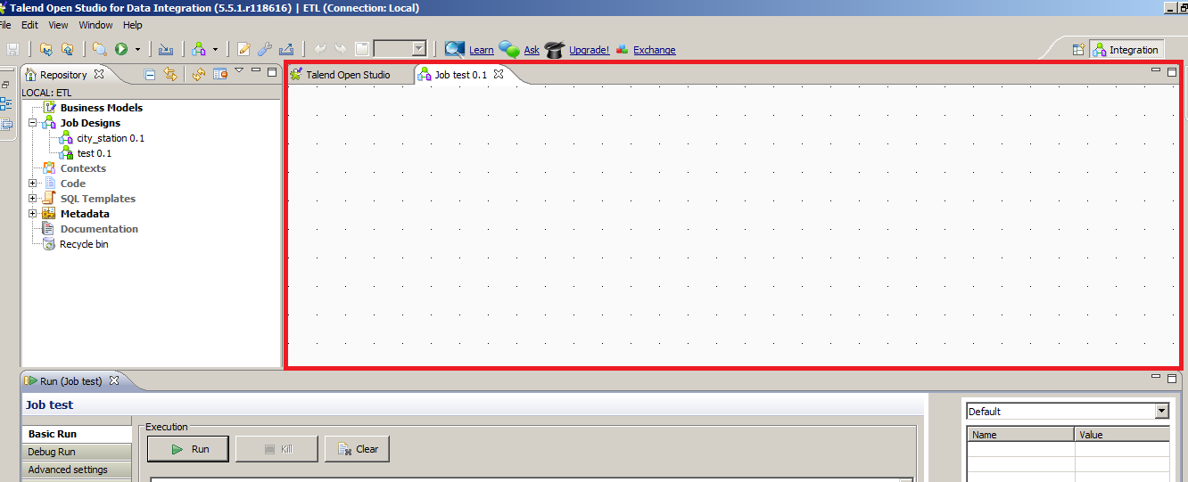
The design workspace
The design workspace is in the middle of the Studio where developers place and configure components in order to build the required data integration job.

Slide 13
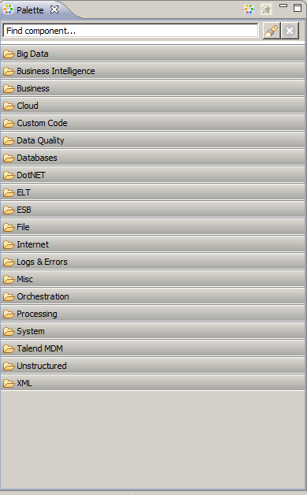
The Palette
The Palette is located on the right-hand side of the Studio and contains the component that can be used in the data integration jobs.

Slide 14
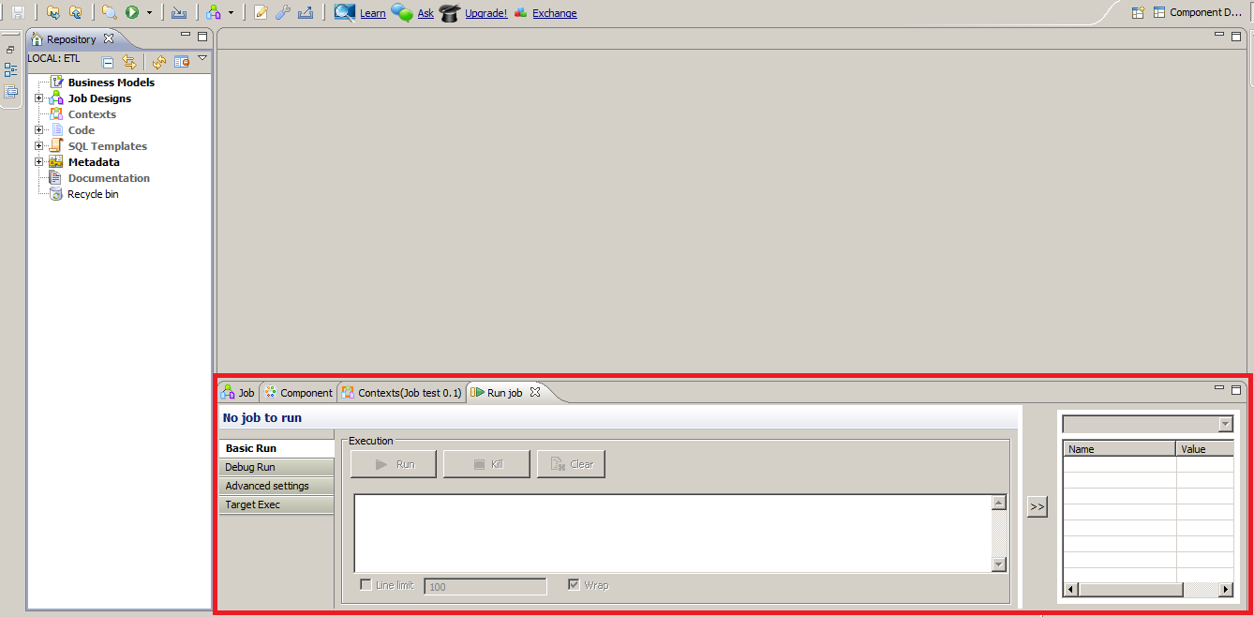
Configuration tabs
The configuration tabs are below the design workspace and they display properties of the job or specific components that are selected in the design workspace.
Copyright © 2014 by Vikram Takkar. All Rights Reserved..

Slide 15
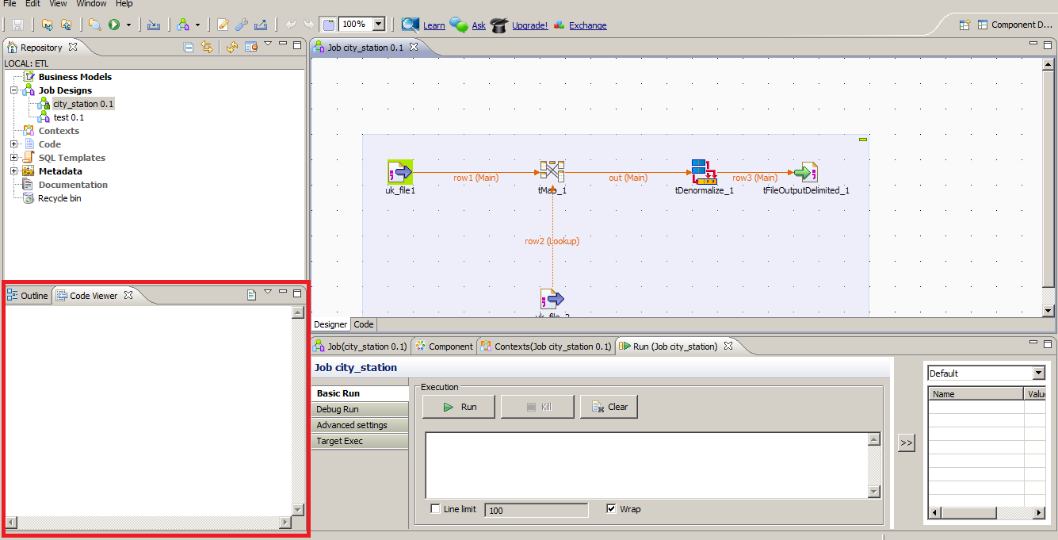
Outline and Code panels
The Outline tab lists the components that have been added to the design workspace and gives quick access to the standard variables for each component.
The Code panel displays the code associated with each component.
Copyright © 2014 by Vikram Takkar. All Rights Reserved..

Slide 16
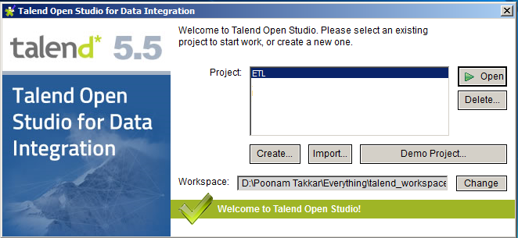
Creating a new project
Start the Studio (or if it is already open, go to File | Switch Project) and wait for the logon screen to appear.
Click on the Create button.
Enter project name and click on the Finish button.
Copyright © 2014 by Vikram Takkar. All Rights Reserved..

Slide 17
Questions?
Copyright © 2014 by Vikram Takkar. All Rights Reserved..

